Slide 1
Ashwik Rajendra Bire
Date - 17-05-2022

Slide 2
Introduction - conference room light controller with bidirectional visitor counter is reliable to take over the tasks of controlling the room light as well as counting number of persons/visitors in the room very accurately. when somebody enters into the room then the counter is incremented by one and the light will switched ON and when visitor leaves the room then counter is decremented by one. The total number of person is also displayed on the LCD.

Slide 3
Project Overview - The microcontroller receives the signals from the sensors, and this signal is operated under the control of software which is stored in ROM. Microcontroller AT89S52 continuously monitors the Infrared Receivers. When any object pass through the IR Receiver's then the IR Rays falling on the receiver are obstructed , this obstruction is sensed by the Microcontroller.

Slide 4
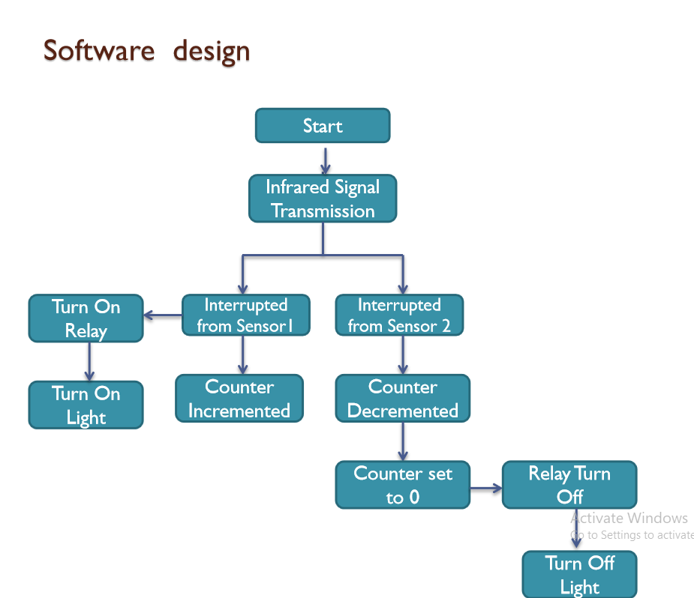

Slide 5
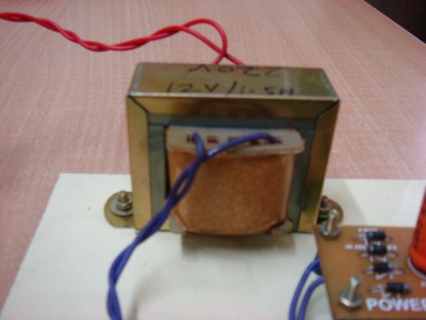
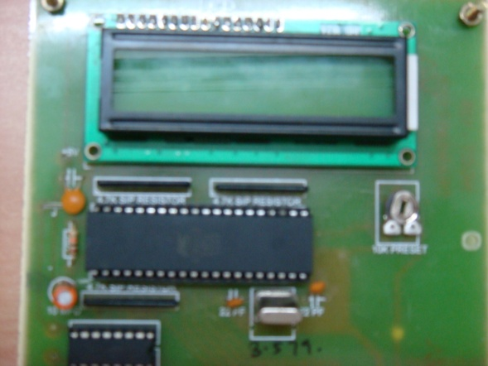
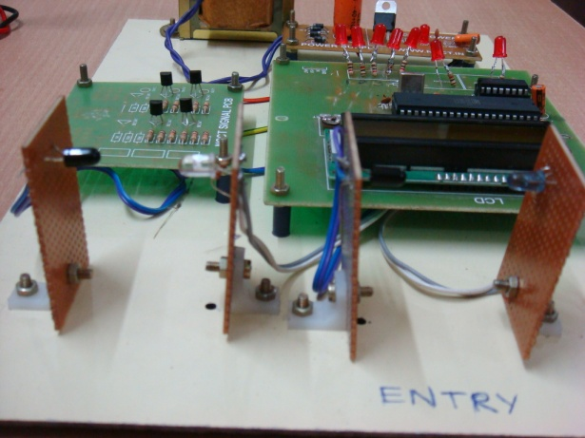
List of Componants - Microcontroller – AT89S52 IC – 7805 Sensor – TSOP 1738 (Infrared Sensor) Transformer – step down 220V/12V Preset – 10K Disc capacitor – Reset button switch Rectifier diode – Bridge rectifier Transistor – BC 547, CL 100 LCD display

Slide 6
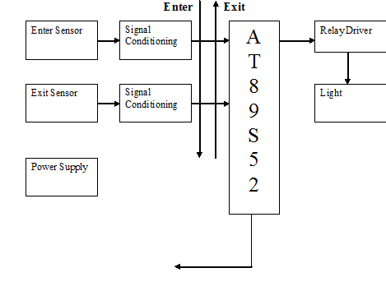
Block Diagram -

Slide 7
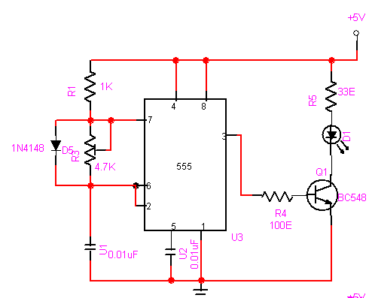
Transmission Circuit

Slide 8
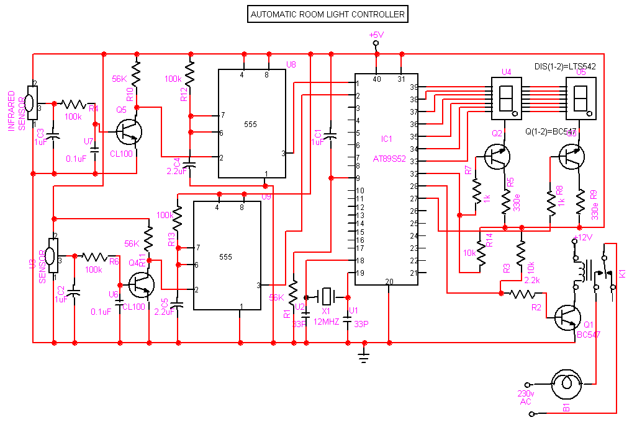
Reciever Circuit

Slide 9
Future Expansion -
- By using this circuit and proper power supply we can implement various applications
Such as fans, tube lights, etc.
- By modifying this circuit and using two relays we can achieve a task of opening and closing the door.

Slide 10
Application - - for counting purpose - for automation purpose
Advantages -
Low cost
Easy to use
Implement in single door
Disadvantage -
It is used only when one single person cuts the rays of the sensor hence it cannot be used when two person cross simultaneously.

Slide 11
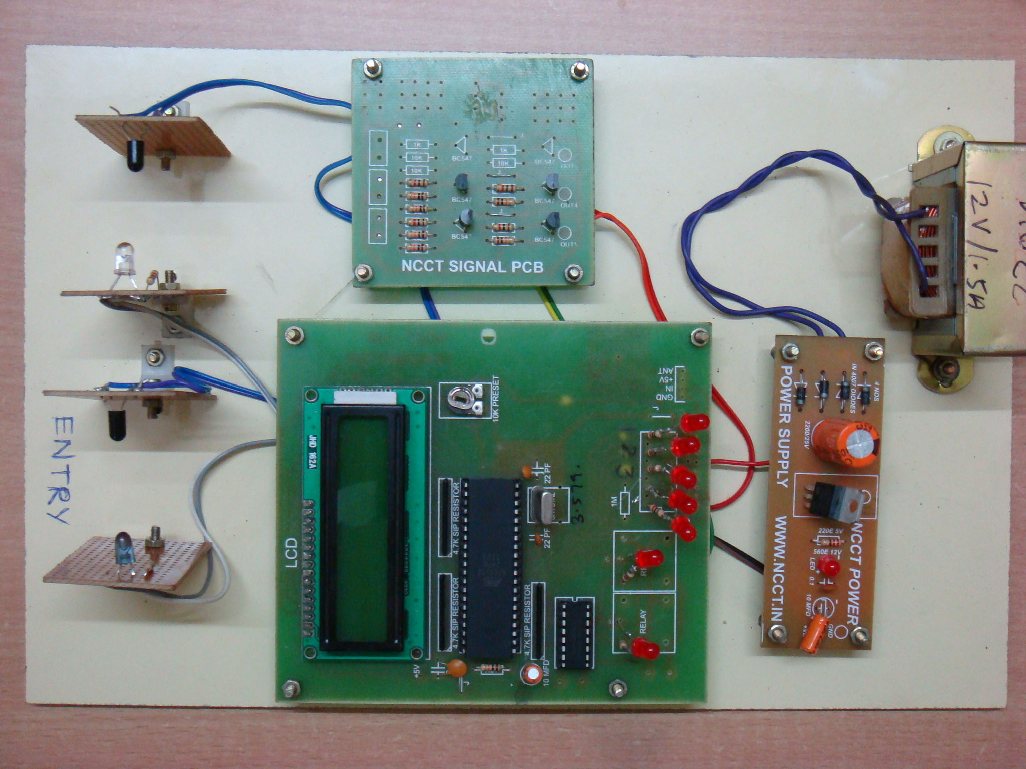

Slide 12
GitHub Repository Link -

Slide 13
Thank You
Ashwik Bire

